Slide 1




EMPLOYEE
DATA
ANALYSIS
MADE BY:- ANKUSH RAWAL

Slide 2


Introduction
This Presentation represents my second task in my Data Analyst internship with PSYLIQ.
The task is to answer questions using MS Excel and Power BI.
The data is about Employee data details.
The dataset consists of 4 excel files (Employee Data, Employee Engagement Survey Data, Training and Development Data and Recruitment Data).

Slide 3
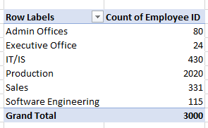
Can you create a pivot table to summarize the total number of employees in each department?

Slide 4
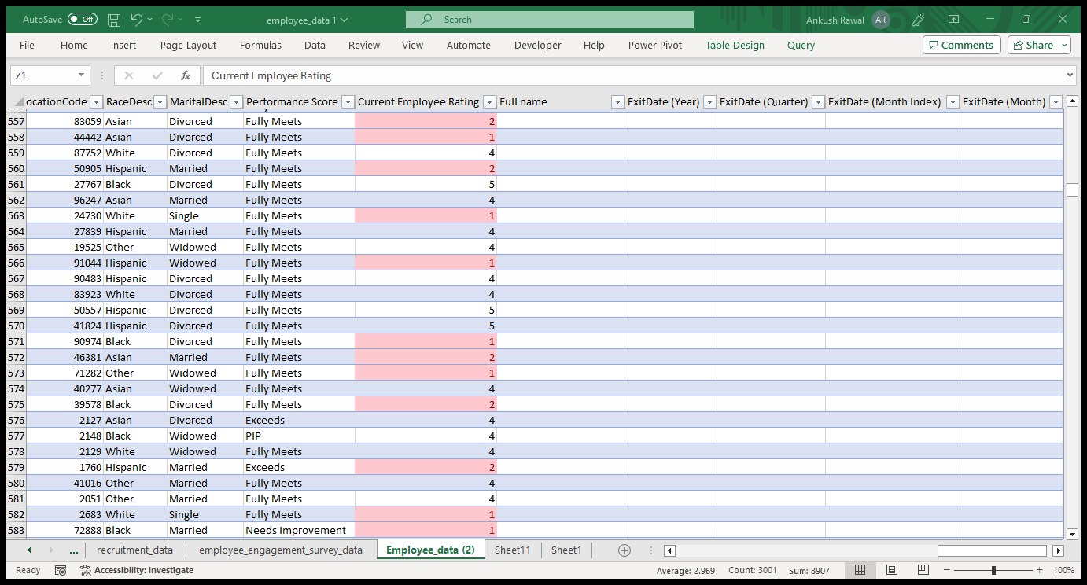
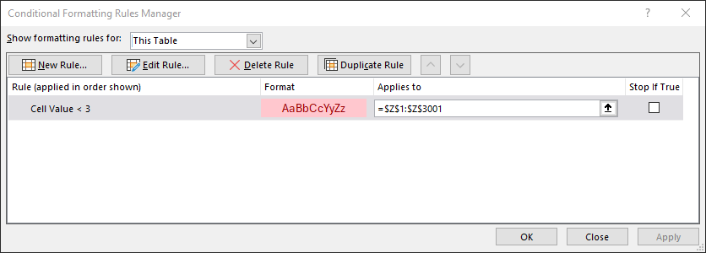
Apply conditional formatting to highlight employees with a "Performance Score" below 3 in red.

Slide 5
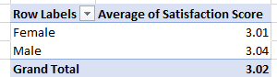
Calculate the average "Satisfaction Score" for male and female employees separately using a pivot table.

Slide 6
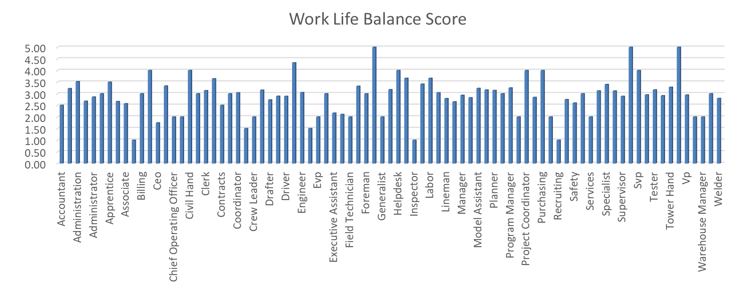
Create a chart to visualize the distribution of "Work-Life Balance Score" for different job functions.

Slide 7
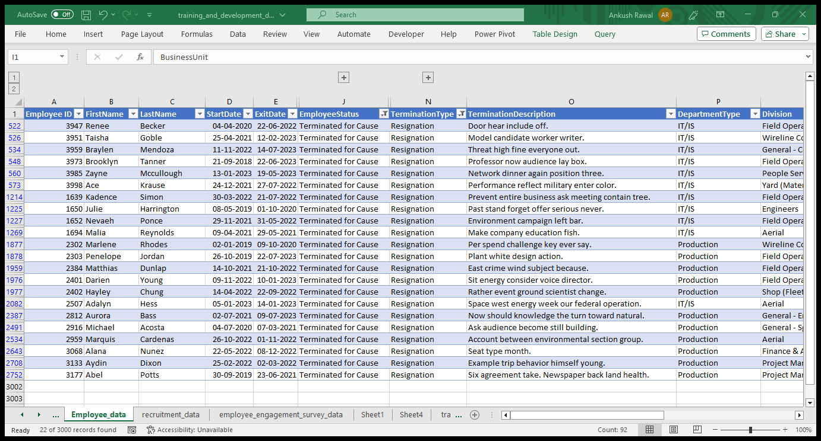
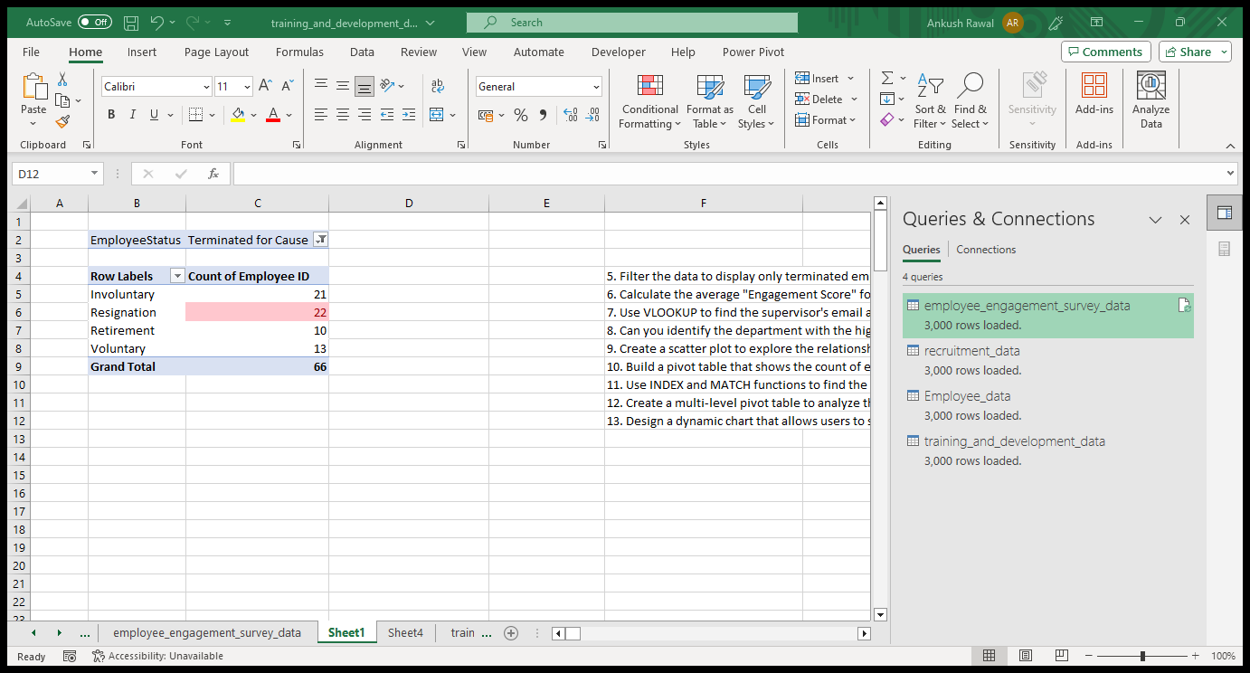
Filter the data to display only terminated employees and find out the most common "Termination Type."

Slide 8
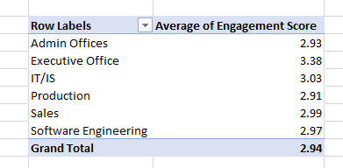
Calculate the average "Engagement Score" for each department using a pivot table.

Slide 9
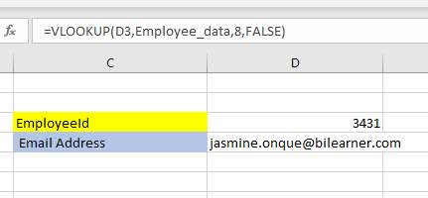
Use VLOOKUP to find the supervisor's email address for a specific employee.

Slide 10
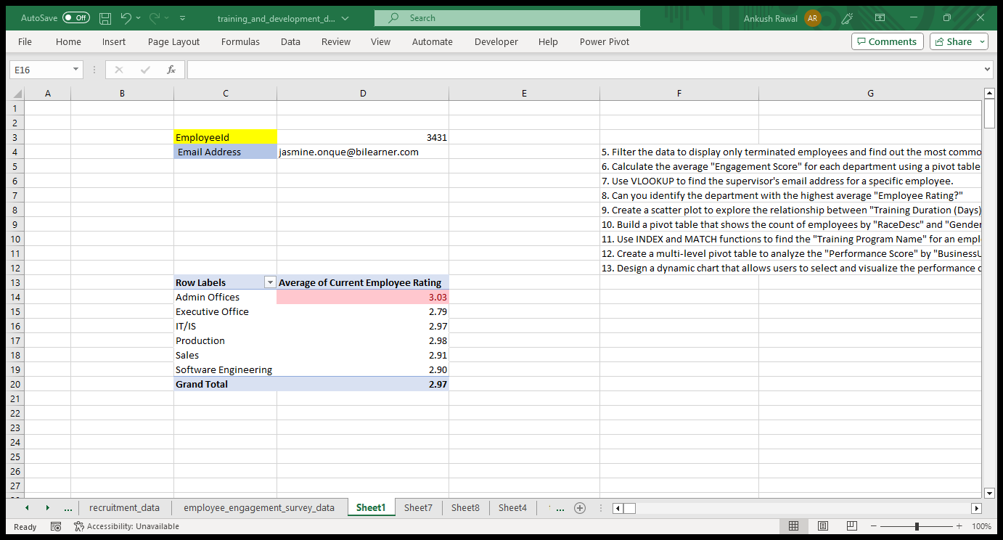
Can you identify the department with the highest average "Employee Rating?"

Slide 11
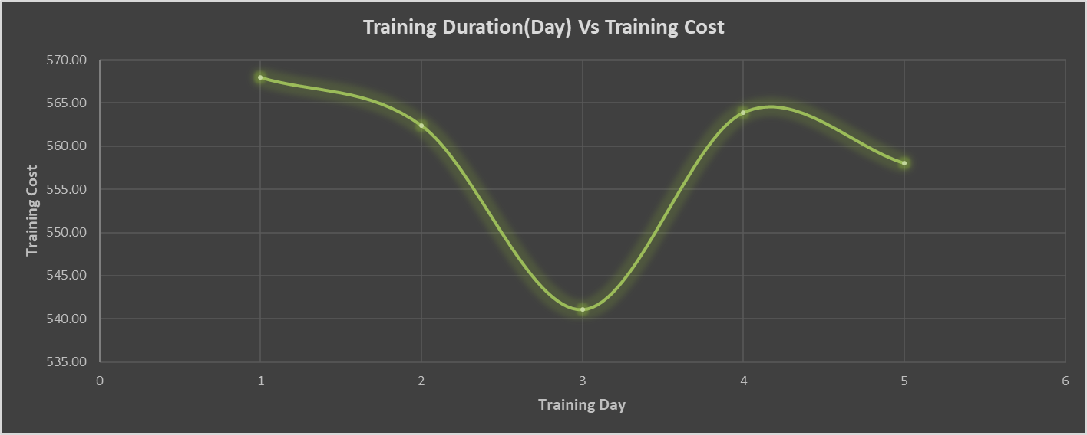
Create a scatter plot to explore the relationship between "Training Duration (Days)" and "Training Cost."

Slide 12
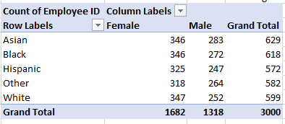
Build a pivot table that shows the count of employees by "RaceDesc" and "GenderCode."

Slide 13
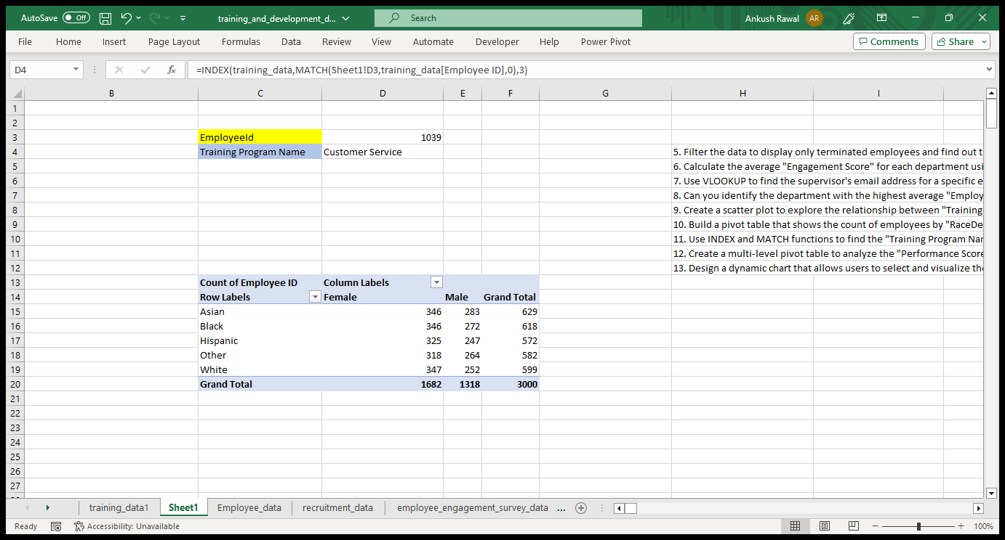
Use INDEX and MATCH functions to find the "Training Program Name" for an employee with a specific ID.

Slide 14
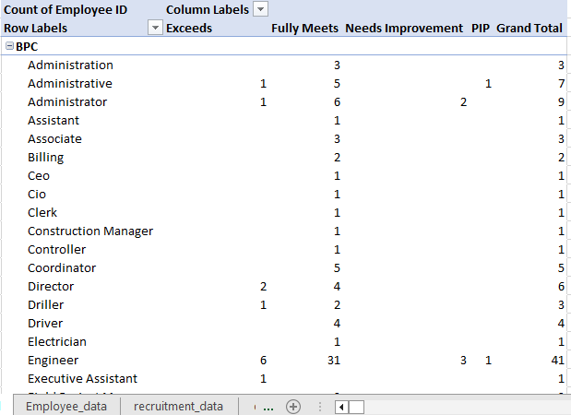
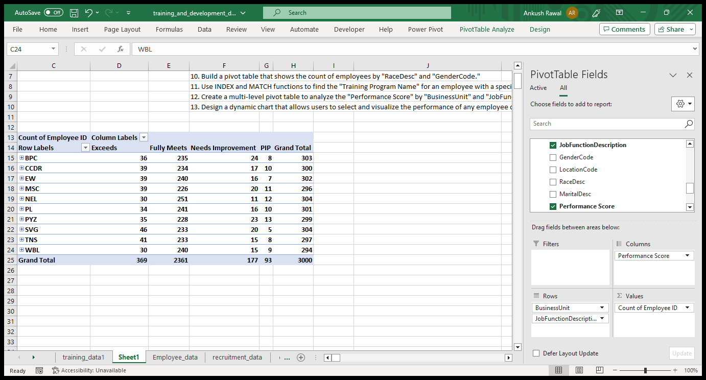
Create a multi-level pivot table to analyze the "Performance Score" by "BusinessUnit" and "JobFunctionDescription."

Slide 15
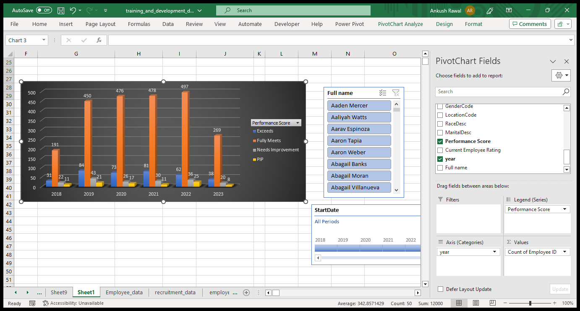
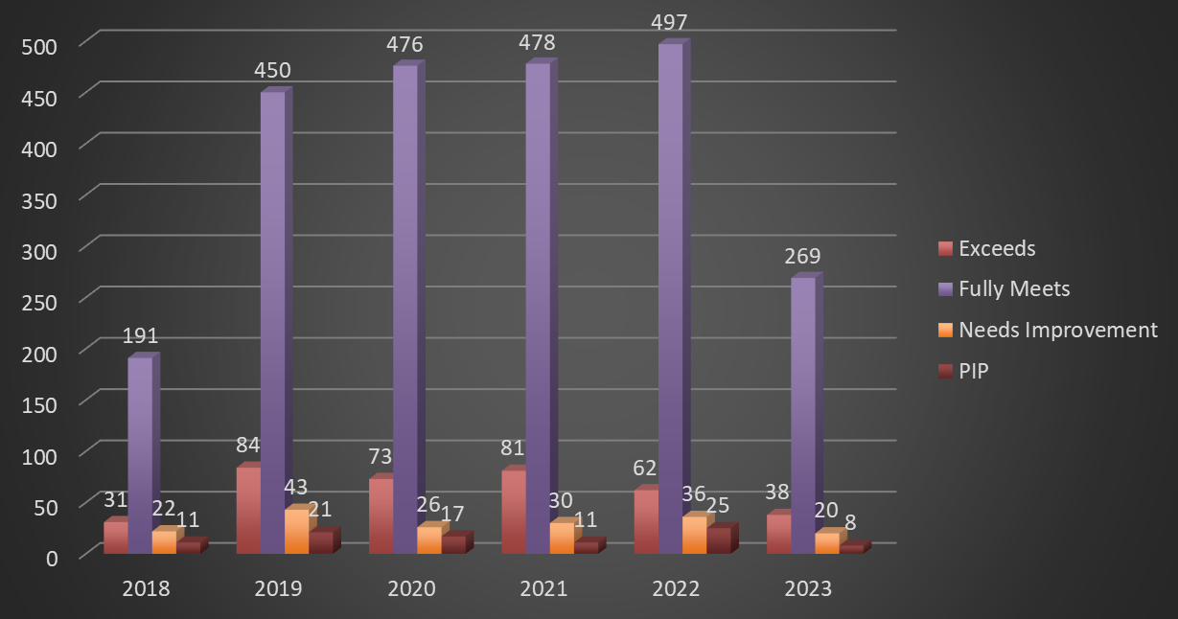
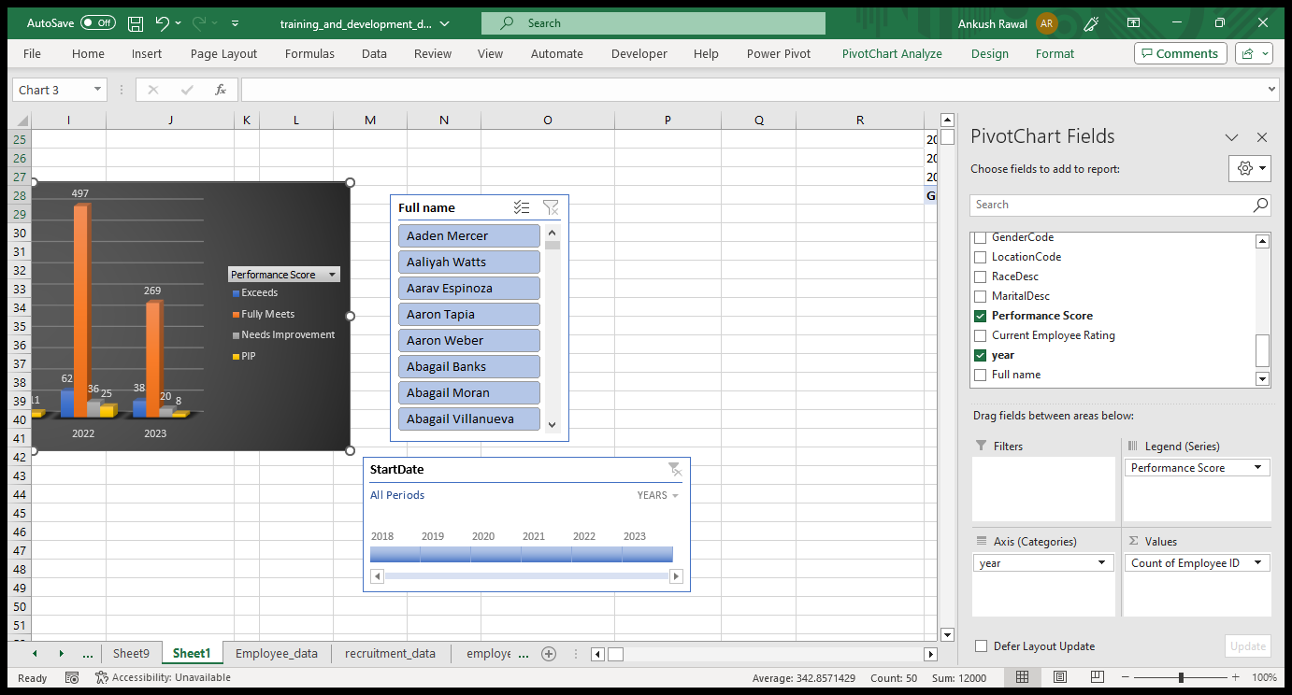
Design a dynamic chart that allows users to select and visualize the performance of any employee over time.

Slide 16
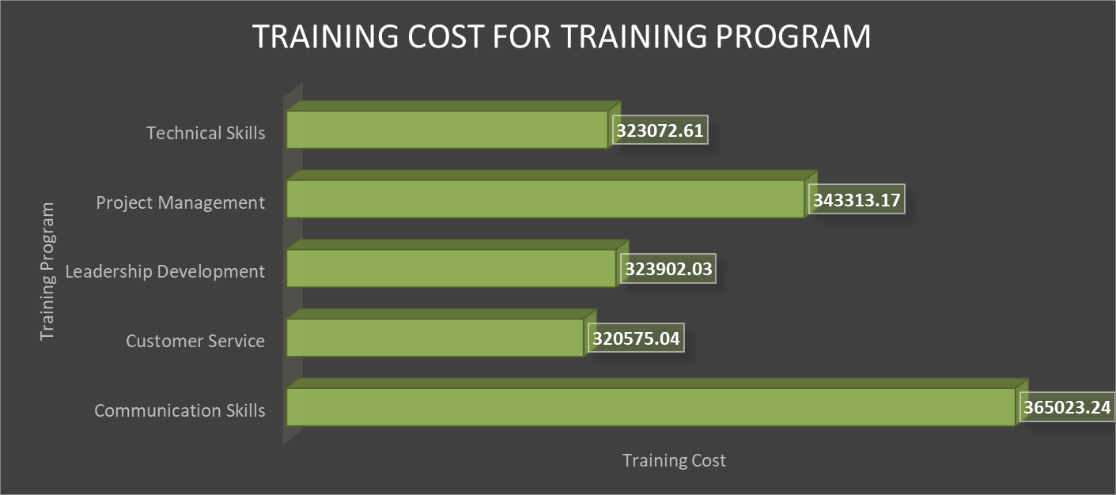
Calculate the total training cost for each "Training Program Name" and display it in a bar chart.

Slide 17
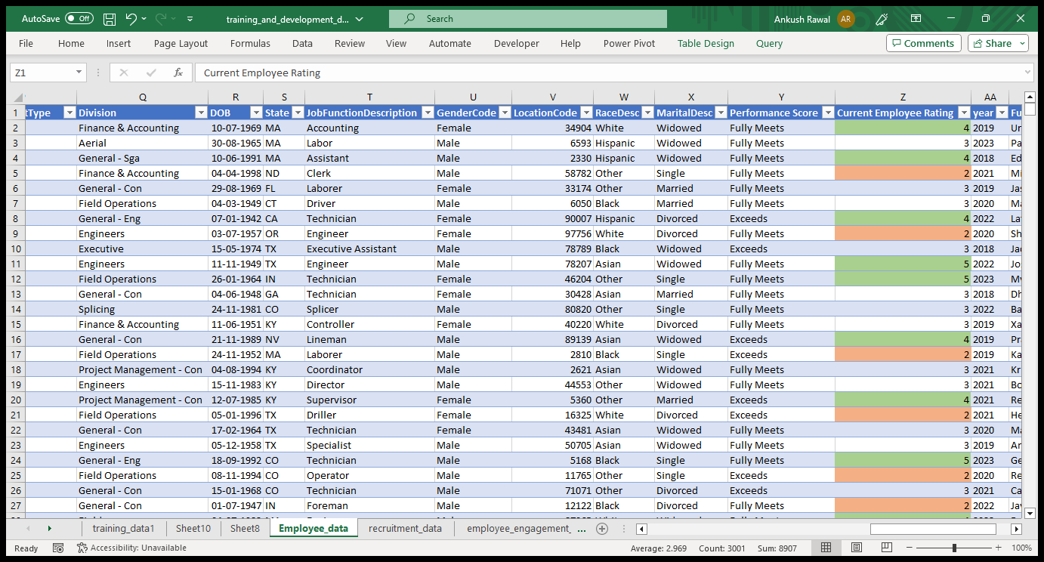
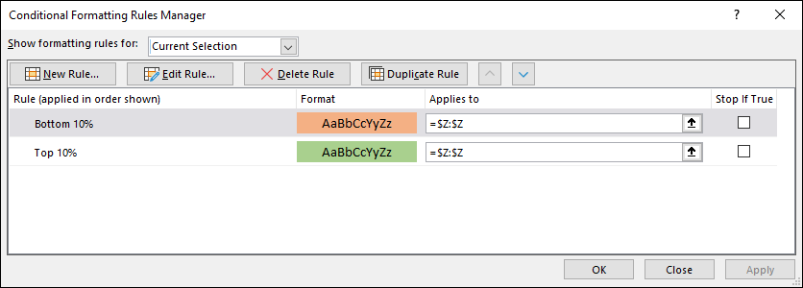
Apply advanced conditional formatting to highlight the top 10% and bottom 10% of employees based on "Current Employee Rating."

Slide 18
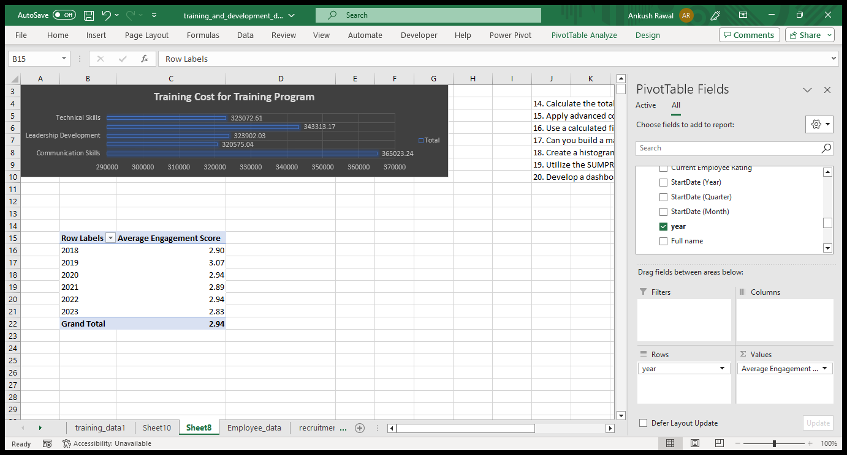
Use a calculated field in a pivot table to determine the average "Engagement Score" per year.

Slide 19
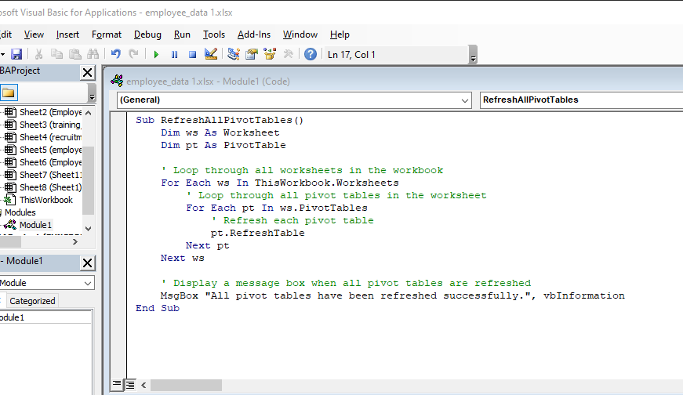
Can you build a macro that automates the process of updating and refreshing all pivot tables in the workbook?

Slide 20
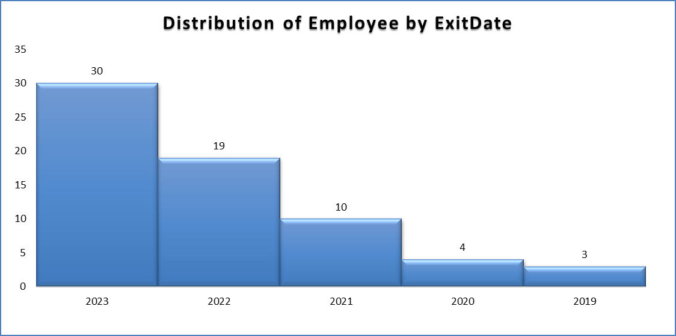
Create a histogram to understand the distribution of "ExitDate" for terminated employees.

Slide 21
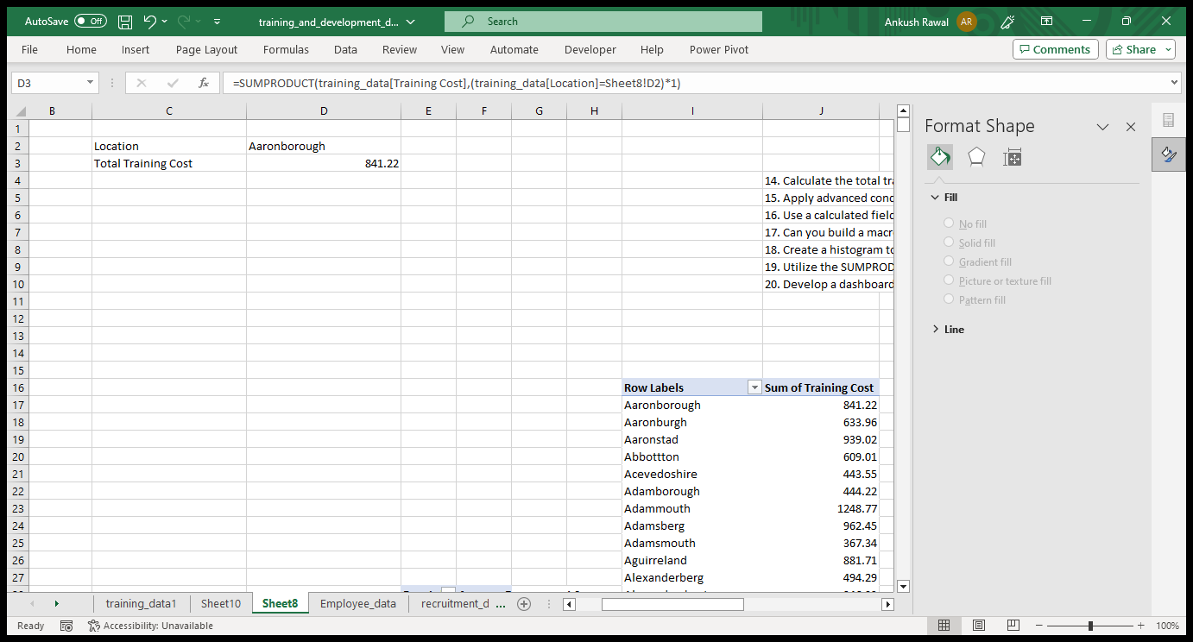
Utilize the SUMPRODUCT function to calculate the total training cost for employees in a specific location.

Slide 22
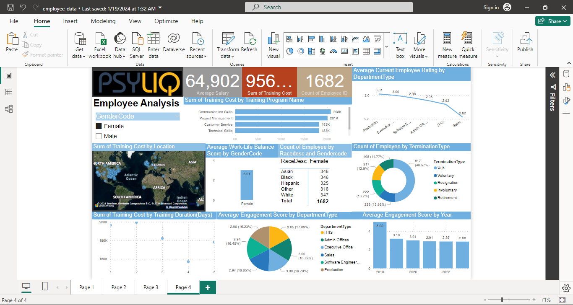
PHOTO OR OTHER MEDIA #1

Slide 23

Thank you

